Slide 1
Marketing Mix Analysis
For Automobile Industry
Lin Chen
Danyang Zhang
Aishwarya Pawar
Amey Athley
Jayant Raisinghani

Slide 2
4Ps Marketing Mix
Product
The product is either a tangible good or an intangible good.
The benefits offered by the product and all its features need to be understood and the unique selling proposition of the product need to be studied
Price
Price covers the actual amount the user is expected to pay for a product.
This is linked to what the perceived value of the product is to the customer rather than the objective costing of the product on offer.
Promotion
Promotion include advertising, sales promotions, special offers and public relations.
Whatever the channel used, it is necessary for it to be suitable for the product, the price and the user it is being marketed to.
Place
Place has to do with how the product will be provided to the customer. Distribution is a key element of placement. The placement strategy will help assess what channel is the most suited to a product.

Slide 3
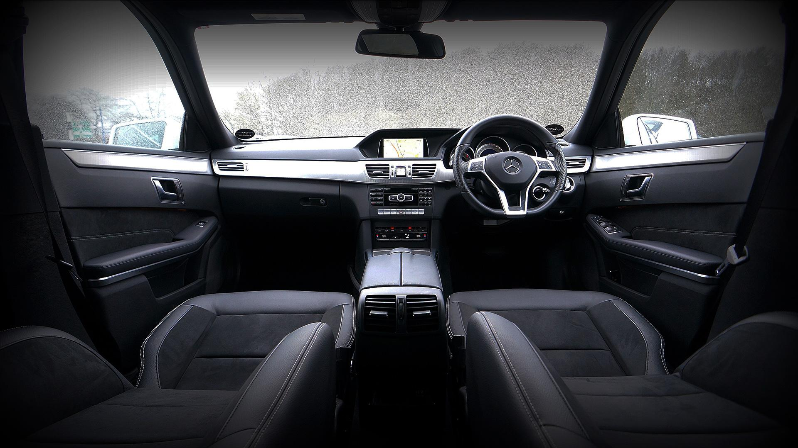

What is marketing mix modelling?
Multivariate regression analysis to assess impact of marketing channels & optimize marketing strategies
Applications:
Quantify impact of each marketing channel
Optimize marketing expenditure
Improve customer targeting

Slide 4



Marketing Mix in Automobile Industry
Business Problem :
How to measure the effectiveness of marketing strategies across multiple channels at different price points for the Automobile industry?
Data Available:
Advertising spending data
Monthly channels spending across overall company and specified brands and model line
Auto information
Annual Brand sales
End goal questions
Which channels are effective in marketing automobiles?
How does the effect of marketing channels change across different automobile segments?
How does price elasticity vary across different segments?
Notes:
Product/ Price/Promotion(Channels)
The automotive sector is the second-largest industry in the United States, generating billions of dollars in annual economic activity and supporting millions of jobs. Automotive market is heavily investing in advertising. As we know, manufacturers and dealers spend millions of dollars to advertise through different channels. For example, this year’s super bowl, of the 56 commercials than run during the game, six were automotive.
According to the National Automobile Dealers Association research, Average dealership advertising per new unit sold was around $600 in 2002. How to allocate the ad spending and utilize it fully is the problem interests car makers, dealers and us. In this problem, we know intuition is not enough, so our business problem is to measure the effectiveness of marketing strategy across multiple channels to see their impact on overall market controlling the avg price of the model-line. Besides that, we want to dig into the multidimensional aspects like domestic cars and international car or luxury cars and non-luxury cars. We will talk about these segments in details.
Thanks Professor Sonnor for giving us the such amazing ‘insider datasets’. One is advertising spending data includes the monthly channel’s spending across different companies, brands and model. The timeline of this dataset is 1995 to 2007. Another one includes the car sales volume and car attributes. The period ranges from 1970s to 2005 with some missing years for different kinds of model-line.
Our goal is to firstly identify the effective channels and measure the effectiveness across different segmentation. After that, we want to calculate the price elasticity of channels and give our recommendation of optimizing ad spending distribution.

Slide 5
Data Wrangling
Extracted brand and model-line from product column in the ad spending data and generated the new columns (brand, model-line)
e.g. Acura CL : Asian Passenger Auto —> (Acura, CL)
Dropped rows that without model-line
e.g. A lot of ad spending focused on company general level, exclude them
Filtered the unlikely combination of brand and model-line
Matching ad spending data with auto information based on the combination of brand and model line
Aggregate the channel spending by ID(brand, model line) and year
Merged sales data and ad spending data by the (brand, model-line)
Results:
50k rows of ad spending reduced to 700 rows
The collection period, model line information are largely different, resulting in the loss of data.
Notes:
Due to the confidential contract we signed, we didn’t show the data here. However, I’d like to let you know that data preprocessing is a big obstacle to tackle down. We have over 50k rows of advertising product that are not explicitly telling what car they are promoting.
First, we used two data source to create three datasets, ad spending, auto sales and auto information.
In the monthly advertising data. we first extracted brand and model-line from product column and generated the new columns of brand and model-line. As in the example, brand and model line keywords are embedded in the short sentence, we use the precision matching to do that.
Then we merge the sales data and ad spending data by the brand and model-line and dropped those rows without model-line. We have to drop these rows without model-line because you cannot attribute the spending on the overall company to a specific model-line.
Since we used the precision matching, it generated some unlikely combination. For instance, there is a deal called Lincoln mercury Auto promoting continental model-line. For this record, it generated two rows as Lincoln, continental and Mercury continental but Mercury didn’t have the continental model-line.
After filtering the unlikely combination of brand and model-line, spending and sales data merge with auto information to get the ID. ID is unique on the brand and model line level.
Finally, we aggregate the channel spending and sales by ID and year.
As we were preprocessing data, we realized the collection period, model line information are largely different in those two datasets, resulting in the loss of data.

Slide 6
Feature Selection
Combined channels into TV, Print, Radio, Online and Outdoor
Added average price of each model
Added “Year” dummies to take consideration of influence of different years
Added “Brand” dummies to take consideration of influence of different brands

Slide 7

Overall
0.
0.
0.21%
1% increase in TV ad spend increased the car sales by 0.21%
-0.54%
1% increase in car price decreased the car sales by 0.54%

Slide 8
Luxury Cars
0.
0.
0.24%
1% increase in TV ad spend increased the car sales by 0.24%
-0.34%
1% increase in car price decreased the car sales by 0.34%

Slide 9
Non-Luxury Cars
0.
0.
0.17%
1% increase in TV ad spend increased the car sales by 0.17%
-0.54%
1% decrease in car price increased the car sales by 0.54%

Slide 10



International Cars
0.13%
0.07%
0.08%
-2.32%
1% increase in TV ad spend increases car sales by 0.13%
1% increase in Radio ad spend increases car sales by 0.07%
1% increase in Print ad spend increases car sales by 0.08%
1% decrease in car price increases car sales by 2.32%

Slide 11

Domestic Cars
0.21%
0.02%
-0.30%
1% increase in TV ad spend increased the car sales by 0.21%
1% increase in Online ad spend increased the car sales by 0.02%
1% increase in car price decreased the car sales by 0.30%

Slide 12

Optimization
Dorfman & Steiner demonstrated the optimal level of advertising occurs when the advertising to sales ratio is equal to the ratio of the advertising elasticity to the price elasticity
 | Overall | Luxury | Non Luxury | International | Domestic
Elasticity Ratio | 0.43 | 0.83 | 0.37 | 0.12 | 0.67
Adspend/ Sales | 0.42 | 0.66 | 0.36 | 0.38 | 0.72
For Luxury models and international brands, the current marketing mix is not optimal and hence there is a potential to optimize it by changing price and channel ad spend mix

Slide 13
Recommendations
For Non-Luxury models, the market is more sensitive towards prices as compared to Luxury models
Price centric advertisement campaigns are more likely to be effective for non-luxury segment
Among the channels, television has the most impact on driving sales across segments
For International brands, print media and radio , along with TV are observed to have potential of driving sales
By smaller change in price, International brands would be able to capture more sales compared to domestic models; as they are more price sensitive

Slide 14
Future Scope
Incorporation of monthly trends to calculate inter-advertising spends precisely
Seasonal effect on channel mix
Lag effect on channel mix
With online channel information, sales attribution for the channels would be possible. This attribution is not possible with current level of information for offline ad spend
Using marketing mix model for future vehicle launches to optimize marketing strategy for pricing and ad spend
Notes:
Seasonality effect : in particular months of year (holidays) - people
Lag effect : if i want to launch a product, after how many months should i launch it? (example)

Slide 15
Questions?

